Slide 1



Manufacturing After high school
Keri Martin
Youth Apprenticeship Coordinator
RTMA/FLYAP

Slide 2
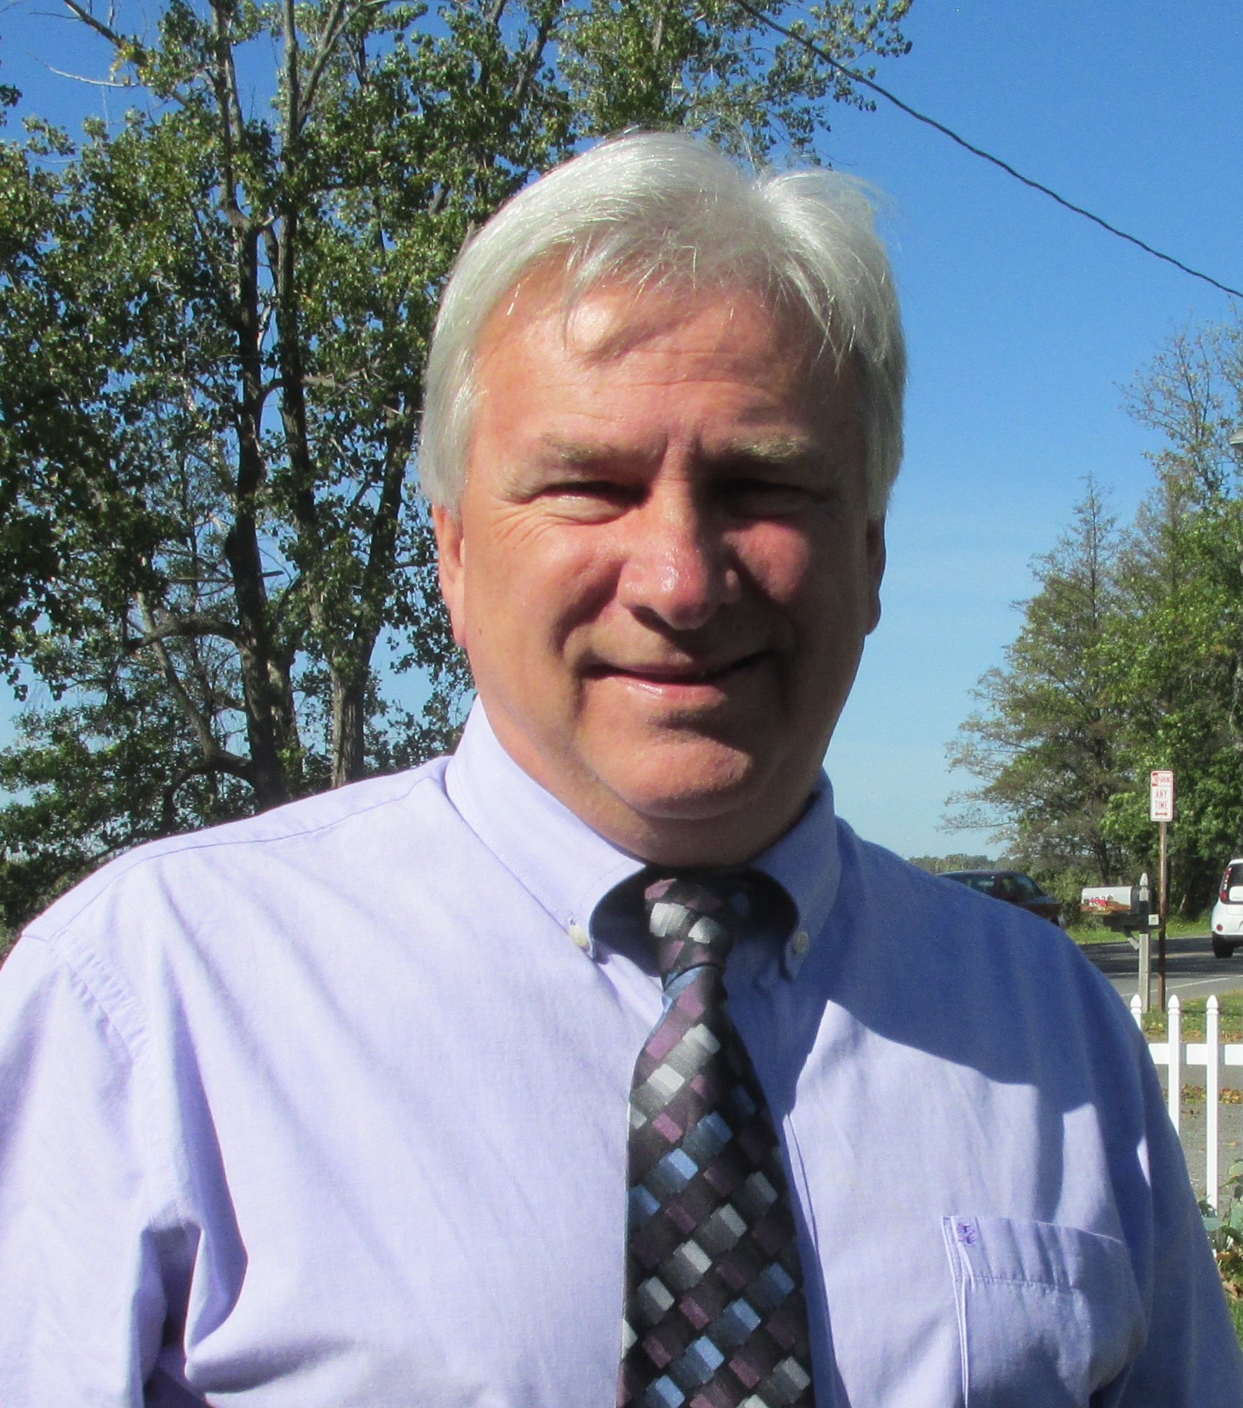
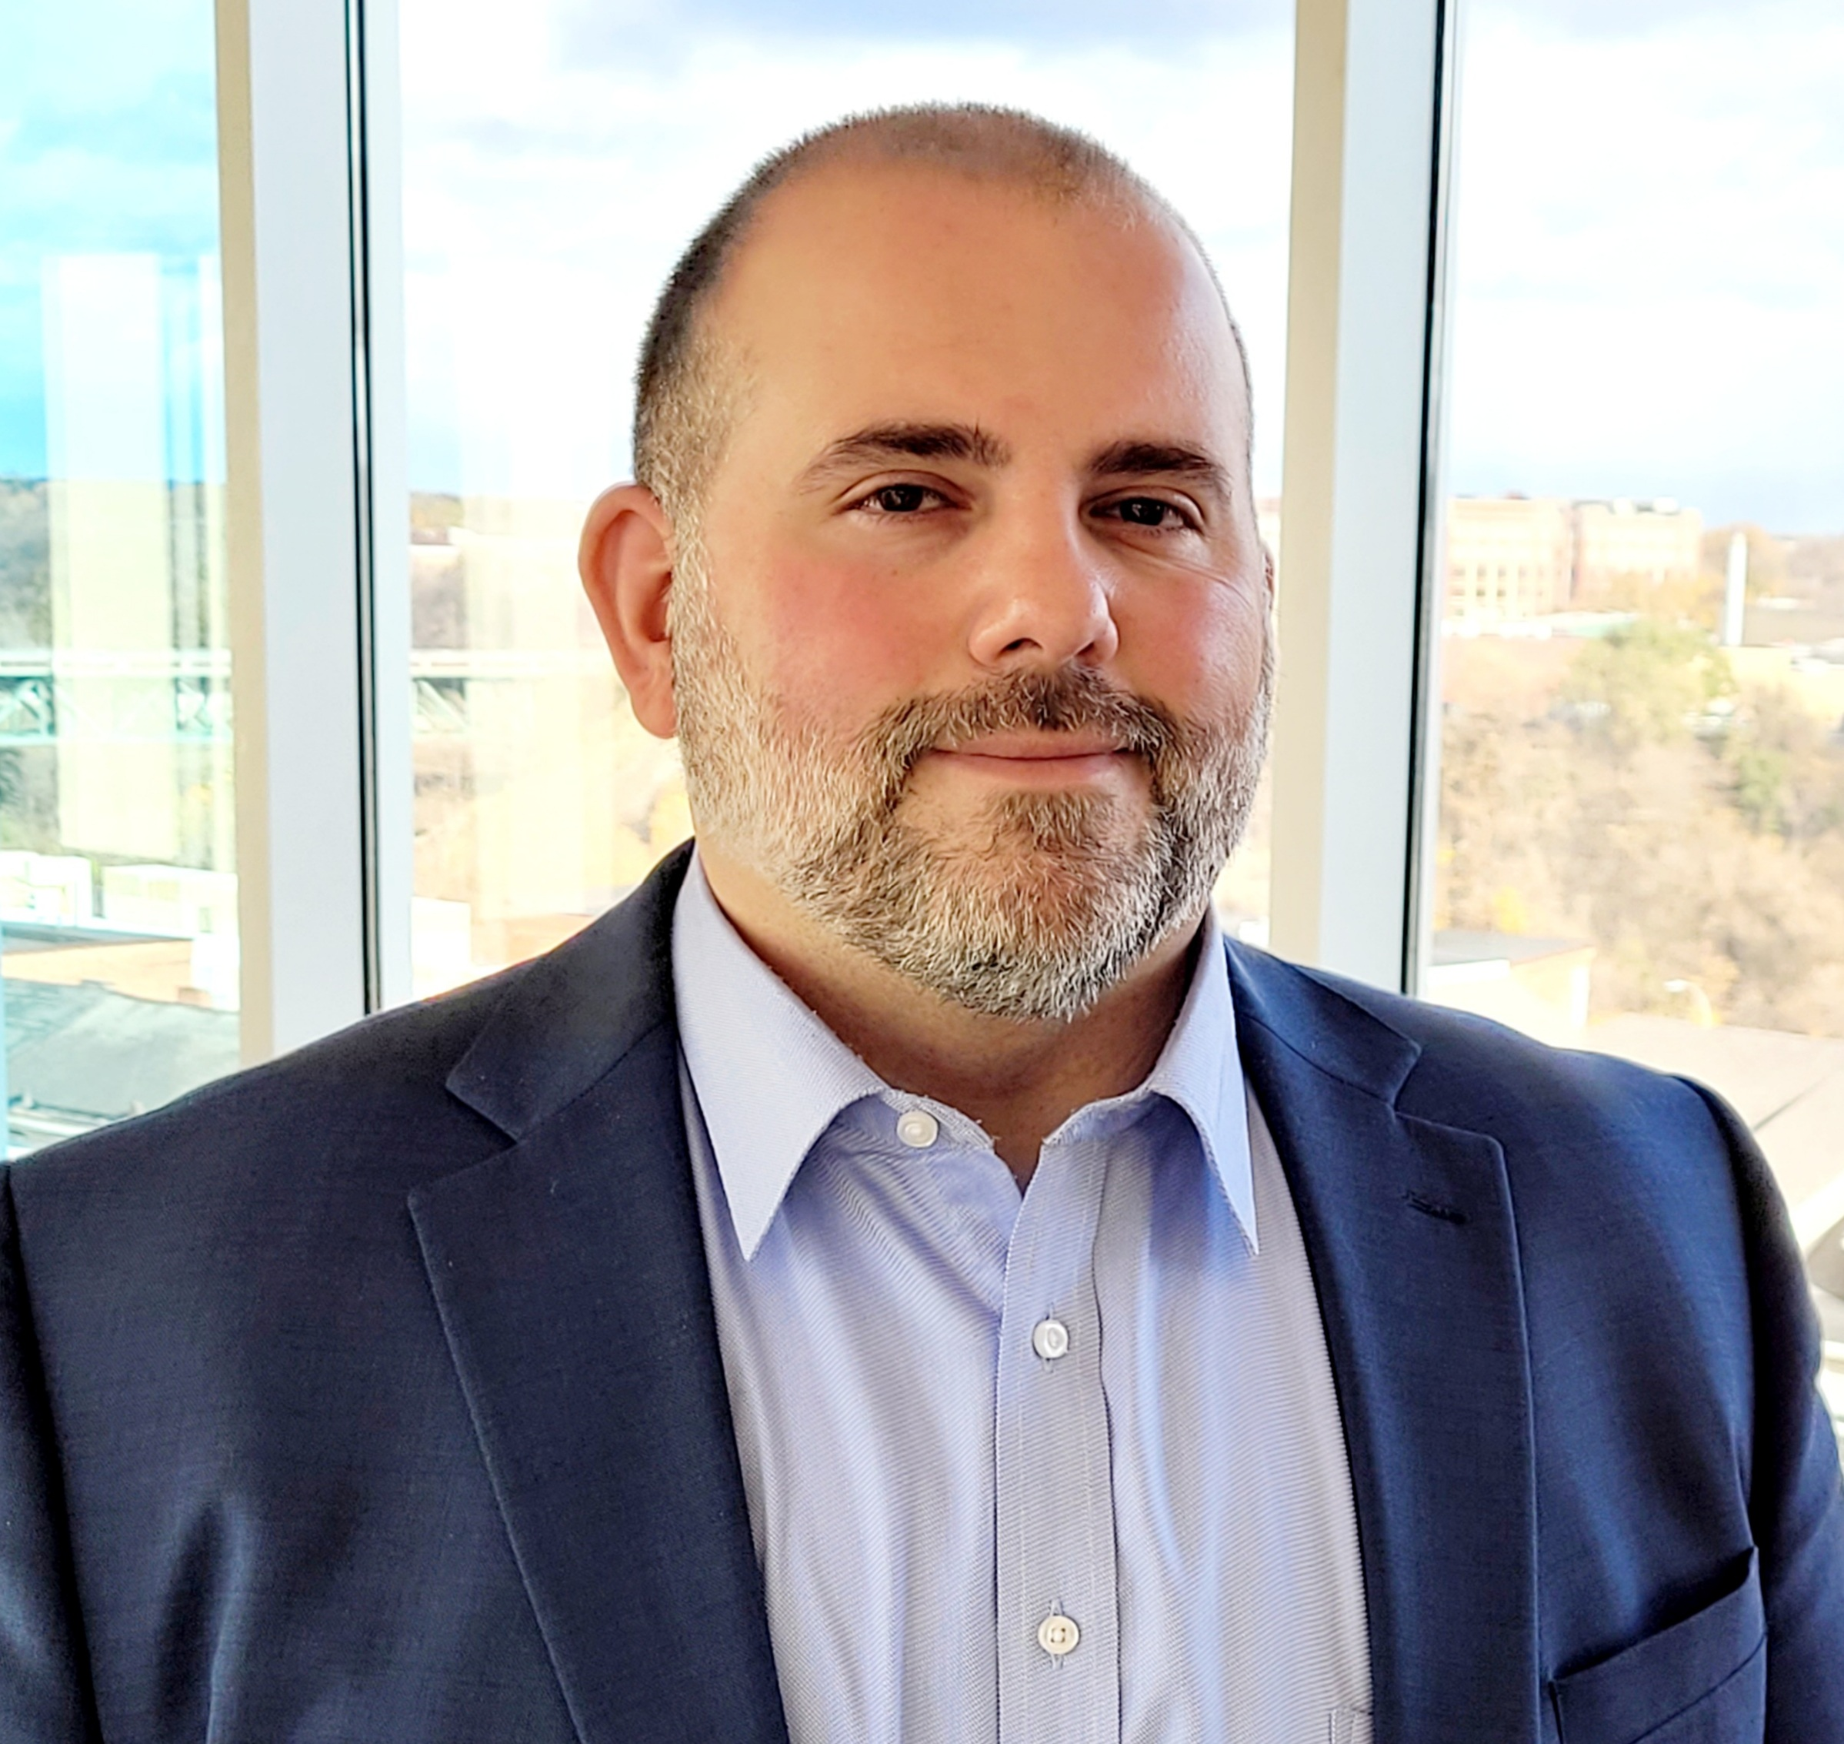

Rich Turner
Director of Workforce Development, RTMA
Business Liaison FLYAP
Mike Smith
Apprenticeship Manager, MCC
Apprenticeship Support, FLYAP
Youth Apprenticeship Coordinator, RTMA
School/Educator, & Parent Liaison, FLYAP

Slide 3
RTMA; Who are we?
We are a group sponsor of the NYS Registered Apprenticeship Program.
A group sponsor means we take care of all the logistics for apprenticeships within a companies' apprenticeship program.
We work for the companies to support with what ever they need.
We secure funding, as well as different incentives needed by the companies to support their growing workforce!
There are 6 of us within the company.

Slide 4
Advanced Manufacturing
What is it?
Advanced Manufacturing is the use of innovative technologies and methods to improve efficiency and competitiveness in the manufacturing sector
Manufacturing isn’t going away
Everything around us has some part that was manufactured
One object could go through multiple parts (Student desk: Welding, machining, etc.)

Slide 5
Careers in Manufacturing
There are more than 1,500 manufacturers in the Greater Rochester, NY region, employing more than 60,000 people. (Greater Rochester Enterprise
https://rochesterbiz.com/advanced-manufacturing)
This sector represents 12% of the local workforce. (Greater Rochester Enterprise
https://rochesterbiz.com/advanced-manufacturing)
Industry is on the edge of technology & innovation
Multiple fields of study: machining, precision optics, maintenance mechanic, electrical & more!
Companies are invested in recruiting and retaining therefore paying for training!

Slide 6
Apprenticeship is higher education
College/career
  $90,000 of debt per student
  33% to 50% of those with debt do not have a college degree
  The national average for tuition is $22,500
Manufacturing Apprenticeships
  Get paid while going to school
  Walk away with no debt from your education courses
  Become a journey worker in 4 years
  Wages are $18-$24 entry level
  Journey worker wages are $25-$35/hour.
  Four-year earnings are $174,720 to $224,460 overall plus benefits and retirement!
Source- National Center for Education Statistics

Slide 7
Schooling
We partner with MCC, GCC, & FLCC to give students opportunities to complete their related instruction
Up to $8,000 dollars for each apprentice towards their education
Our goal is for Journey Workers to complete with no debt

Slide 8
FLYAP
A program created in 2019 between RTMA & MCC—Working to create a pipeline of youth to companies. The goal was to help create a workforce for those who are retiring.
We work with Juniors & Seniors to give them a Shadow experience, or a Paid Co-op within a company.
  They participate in a matching day where they interview with at least 4 companies.
  Students and companies match each other to determine best fit.

Slide 9
FLYAP Success to date
Since our creation in 2019, we have helped over 800 students to get into manufacturing companies
We have worked with over 100 companies to get students in for a shadow experience or paid Co-Op
Of those numbers more than a third of the graduates working in manufacturing.
Several are registered apprentices
Participants can earn dual enrollment credits
Notes:
Talk about not being able to track for actual percentage due to students not answering survey etc.
For example—if you’re in the boces 1 machining class you can earn up to 12 college credits.

Slide 10
We have several events throughout the year!
ROC With Your Hands
Women In Manufacturing
Educator’s Manufacturing Day
National Apprenticeship Week
Notes:
We are always trying to add different events to the calendar

Slide 11
Contact us!
If you have any questions, please reach out to kmartin@rtma.org
Phone:
  Office: 585-410-4278

